Slide 1
Accounting Principles, 7th Edition
Weygandt • Kieso • Kimmel
Chapter 9
Accounting for Receivables
Prepared by Naomi Karolinski
Monroe Community College
and
Marianne Bradford
Bryant College
John Wiley & Sons, Inc. © 2005

Slide 2
CHAPTER 9 ACCOUNTING FOR RECEIVABLES
After studying this chapter, you should be able to:
1 Identify the different types of receivables.
2 Explain how accounts receivable are
recognized in the accounts.
3 Distinguish between the methods and bases
used to value accounts receivable.
4 Describe the entries to record the disposition
of accounts receivable.
5 Compute the maturity date of and interest on
notes receivable.

Slide 3
CHAPTER 9 ACCOUNTING FOR RECEIVABLES
After studying this chapter, you should be able to:
6 Explain how notes receivable are recognized in
the accounts.
7 Describe how notes receivable are valued.
8 Describe the entries to record the disposition of
notes receivable.
9 Explain the statement presentation and analysis
of receivables.

Slide 4

RECEIVABLES
STUDY OBJECTIVE 1
Amounts due from individuals and other companies
  claims expected to be collected in cash
Three major classes of receivables are
  1 Accounts Receivable
  - amounts owed by customers on account
  2 Notes Receivable
  - claims for which formal instruments of credit are issued
  3 Other Receivables –
  - non-trade receivables
  Examples: interest receivable and advances to
  employees

Slide 5
ACCOUNTS RECEIVABLE
Three primary accounting issues with accounts receivable:
1 Recognizing accounts receivable.
2 Valuing accounts receivable.
3 Disposing of accounts receivable.

Slide 6

RECOGNIZING ACCOUNTS RECEIVABLE
STUDY OBJECTIVE 2
July 1 Accounts Receivable – Polo Co. 1,000
Sales 1,000
When a business sells merchandise to a customer on credit, Accounts Receivable is debited and Sales is credited. Assume credit terms are 2/10, n/30.

Slide 7
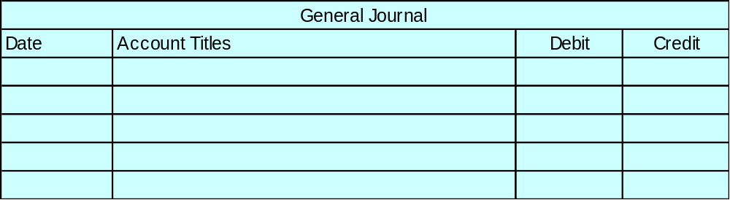
RECOGNIZING ACCOUNTS RECEIVABLE
July 5 Sales Returns and Allowances 100
Accounts Receivable – Polo Company 100
When a business receives returned merchandise previously sold to a customer on credit, Sales Returns and Allowances is debited and Accounts Receivable is credited.
When a business sells merchandise to a customer on credit, Accounts Receivable is debited and Sales is credited.

Slide 8
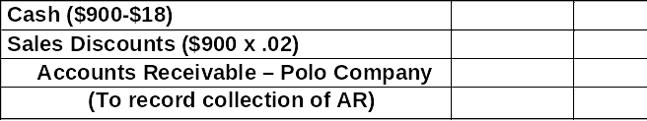
RECOGNIZING ACCOUNTS RECEIVABLE
882
18
900
When a business collects cash from a customer for merchandise previously sold on credit during the discount period, Cash and Sales Discounts are debited and Accounts Receivable is credited.
When a business sells merchandise to a customer on credit, Accounts Receivable is debited and Sales is credited.

Slide 9

VALUING ACCOUNTS RECEIVABLE
STUDY OBJECTIVE 3
Cash (net) realizable value
  net amount expected to be received in cash and excludes amounts that the company estimates it will not be able to collect
Credit losses
  debited to Bad Debts Expense
  considered a normal and necessary risk of doing business.
Two methods of accounting for uncollectible accounts are: 1 Direct write-off method 2 Allowance method

Slide 10
DIRECT WRITE-OFF METHOD
Direct write-off method
  Bad debt losses are not anticipated and no allowance account is used
  No entries are made for bad debts until an account is determined to be uncollectible at which time the loss is charged to Bad Debts Expense
No matching
No cash realizable value of accounts receivable on the balance sheet
Not acceptable for financial reporting purposes

Slide 11
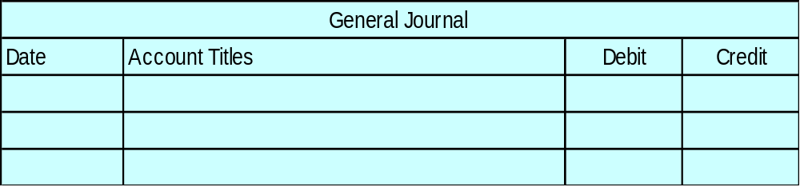
DIRECT WRITE-OFF METHOD
Dec. 12 Bad Debts Expense 200
Accounts Receivable – M.E. Doran 200
Warden Co. writes off M. E. Doran’s $200 balance as uncollectible on December 12. When this method is used, Bad Debts Expense will show only actual losses from uncollectibles.

Slide 12
THE ALLOWANCE METHOD
Allowance method
  required when bad debts are deemed to be material in amount.
Uncollectible accounts are estimated
  expense for the uncollectible accounts is matched against sales in the same accounting period in which the sales occurred.

Slide 13
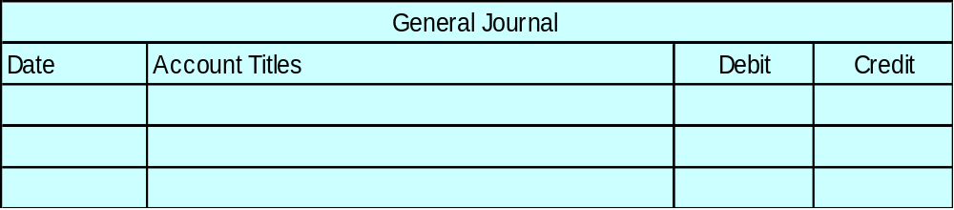
THE ALLOWANCE METHOD
Dec. 31 Bad Debts Expense 12,000
Allowance for Doubtful Accounts 12,000
Estimated uncollectibles are debited to Bad Debts Expense and credited to Allowance for Doubtful Accounts at the end of each period.

Slide 14
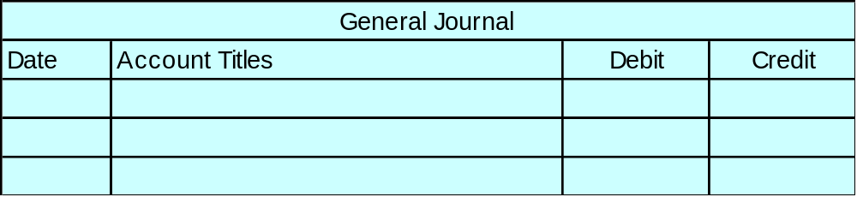
THE ALLOWANCE METHOD
Mar. 1 Allowance for Doubtful Accounts 500
Accounts Receivable - R. A. Ware 500
Actual uncollectibles are debited to Allowance for Doubtful Accounts and credited to Accounts Receivable at the time the specific account is written off.

Slide 15
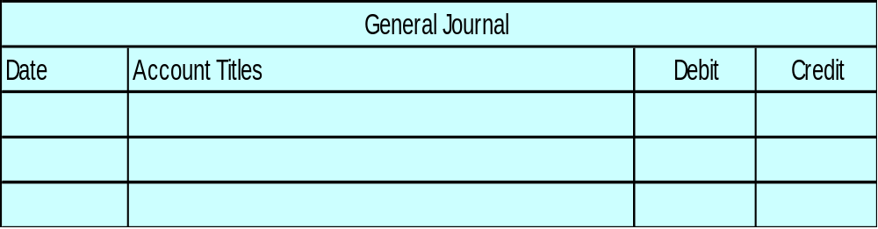
THE ALLOWANCE METHOD
July 1 Accounts Receivable – R. A. Ware 500
Allowance for Doubtful Accounts 500
When there is recovery of an account that has been written off: 1 reverse the entry made to write off the account and...

Slide 16
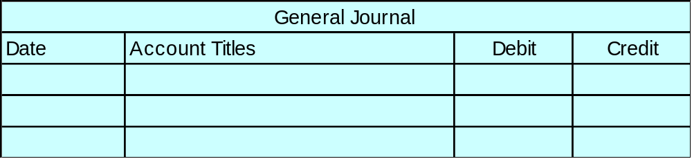
THE ALLOWANCE METHOD
July 1 Cash 500
Accounts Receivable 500
2 record the collection in the usual manner.

Slide 17

BASES USED FOR THE ALLOWANCE METHOD
Companies use one of two methods in the estimation of uncollectibles:
1 Percentage of sales
2 Percentage of receivables
Both bases are GAAP; the choice is a management decision.

Slide 18
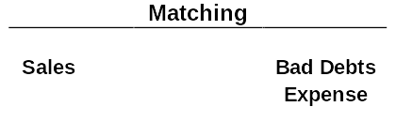

COMPARISON OF BASES OF ESTIMATING UNCOLLECTIBLES
Percentage of Receivables
Percentage of Sales
Emphasis on Income Statement Emphasis on Balance Sheet
Relationships Relationships

Slide 19

PERCENTAGE OF SALES BASIS
Management estimates what percentage of credit sales will be uncollectible.
Expected bad debt losses are determined by applying the percentage to the sales base of the current period.
Better match
  Expenses with revenues

Slide 20
PERCENTAGE OF SALES BASIS
Dec. 31 Bad Debts Expense 8,000
Allowance for Doubtful Accounts 8,000
If net credit sales for the year are $800,000, the estimated bad debts expense is $8,000 (1% X $800,000).

Slide 21
PERCENTAGE OF RECEIVABLES BASIS
Management estimates what percentage of receivables will result in losses from uncollectible accounts.
Amount of the adjusting entry
  difference between the required balance
  and the existing balance in the allowance
  account
Produces the better estimate of cash realizable value of receivables.

Slide 22
Which of the following approaches for bad debts is best described as a balance sheet method?
Review
Percentage of receivables basis.
Direct write-off method.
Percentage of sales basis.
Both a and b.

Slide 23
Which of the following approaches for bad debts is best described as a balance sheet method?
Review
Percentage of receivables basis.
Direct write-off method.
Percentage of sales basis.
Both a and b.

Slide 24
PERCENTAGE OF RECEIVABLES BASIS
Dec. 31 Bad Debts Expense 1,700
Allowance for Doubtful Accounts 1,700
If the trial balance shows Allowance for Doubtful Accounts with a credit balance of $528, and the required ending balance in the account is $2,228, an adjusting entry for $1,700 ($2,228 - $528) is necessary.

Slide 25

DISPOSING OF ACCOUNTS RECEIVABLE
STUDY OBJECTIVE 4
Companies frequently dispose of accounts
receivable in one of two ways:
1 sell to a factor such as a finance company or a bank
factor buys receivables from businesses for a fee and collects the payments directly from customers
2 make credit card sales

Slide 26
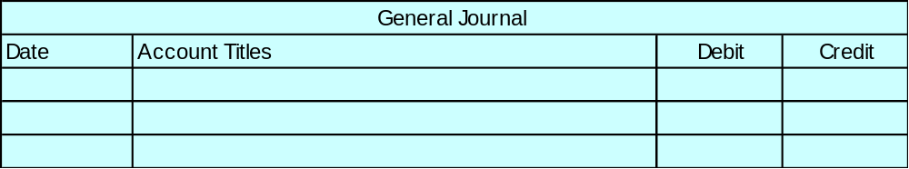
SALE OF RECEIVABLES
Cash 588,000
Service Charge Expense (2% x $600,000) 12,000
Accounts Receivable 600,000
Hendrendon Furniture factors $600,000 of receivables to Federal Factors, Inc. Federal Factors assesses a service charge of 2% of the amount of receivables sold.

Slide 27
CREDIT CARD SALES
Credit cards
  used by retailers who wish to avoid the paperwork of issuing credit
  cash is received quickly from the credit card issuer
National credit cards
  Visa, MasterCard, Discover, and American Express

Slide 28

CREDIT CARD SALES
Three parties
1 credit card issuer
2 retailer
3 customer
Retailer pays the credit card issuer a fee of 2-6% of the invoice price for its services.
From an accounting standpoint, sales from Visa, MasterCard, and Discover are treated differently than sales from American Express.

Slide 29

VISA, MASTERCARD, AND DISCOVER SALES
VISA, MasterCard, and Discover
  cards issued by banks
  considered cash sales by the retailer
Upon receipt of credit card sales slips from a retailer
  the bank immediately adds the amount to the seller’s bank balance

Slide 30
VISA, MASTERCARD, AND DISCOVER SALES
Cash 970
Service Charge Expense 30
Sales 1,000
Anita Ferreri purchases a number of compact discs for her restaurant from Karen Kerr Music Co. for $1,000 using her VISA First Bank Card. The service fee that First Bank charges is 3%.

Slide 31

AMERICAN EXPRESS SALES
American Express cards
  reported as credit sales, not cash sales
Conversion to cash does not occur until the American Express remits the net amount to the seller.

Slide 32
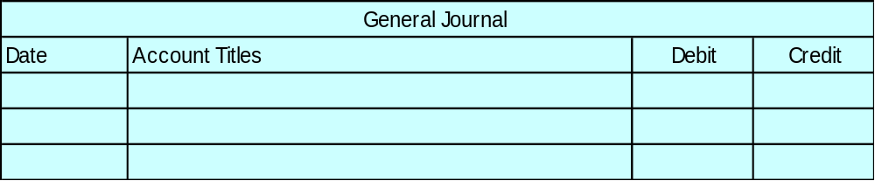
AMERICAN EXPRESS SALES
Accounts Receivable – American Express 285
Service Charge Expense 15
Sales 300
Four Seasons Restaurant accepts an American Express card for a $300 bill. The service fee that American Express charges is 5%.

Slide 33

NOTES RECEIVABLE
Promissory note
  written promise to pay a specified amount of money on demand or at a definite time.
Maker
  The party making the promise.
Payee
  The party to whom payment is made.

Slide 34

NOTES RECEIVABLE
Life of the note expressed in terms of months
  the due date is found by counting the
  months from the date of issue
Example: The maturity date of a 3-month note dated May 31 is August 31.

Slide 35
DETERMINING THE MATURITY DATE
STUDY OBJECTIVE 5
Life of the note is expressed in terms of days
  you need to count the days.
  the date of issue is omitted but the due date is included.
Example: The maturity date of a 60-day note dated July 17 is:
Term of note
60
July 31
–
17
14
August
31
45
Maturity date: September
15

Slide 36
FORMULA FOR COMPUTING INTEREST
The basic formula for computing interest on an interest-bearing note is:
The interest rate specified on the note is an annual rate of interest.
Annual
Interest
Rate
Time
in Terms of
One Year
Face Value
of Note
Interest
X
X
=

Slide 37
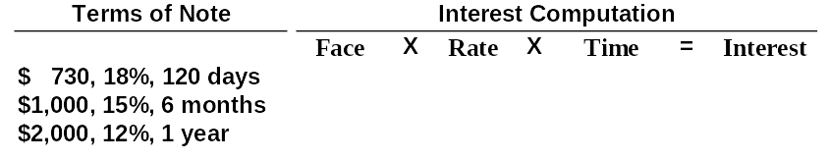
COMPUTATION OF INTEREST
$ 730 X 18% X 120/360 = $ 43.80 $1,000 X 15% X 6/12 = $ 75.00 $2,000 X 12% X 1/1 = $240.00
Helpful hint: The interest rate specified is the annual rate.

Slide 38
RECOGNIZING NOTES RECEIVABLE
STUDY OBJECTIVE 6
May 1 Notes Receivable 1,000
Accounts Receivable – Brent Company 1,000
Wilma Company receives a $1,000, 2-month, 12% promissory note from Brent Company to settle an open account.

Slide 39

VALUING NOTES RECEIVABLE
STUDY OBJECTIVE 7
Like accounts receivable, short-term notes receivable are reported at their cash (net) realizable value.
The notes receivable allowance account is Allowance for Doubtful Accounts.

Slide 40
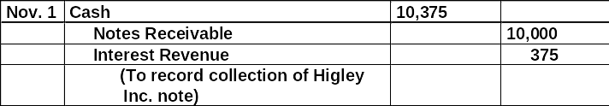
HONOR OF NOTES RECEIVABLE
STUDY OBJECTIVE 8
A note is honored when it is paid in full at its maturity date.
For an interest-bearing note, the amount due at maturity is
the face value of the note plus interest for the length of
time specified on the note.
Betty Co. lends Wayne Higley Inc. $10,000 on June 1, accepting a 5-month, 9% interest-bearing note.
Betty Co. collects the maturity value of the note from Wayne Higley Inc. on November 1.

Slide 41

HONOR OF NOTES RECEIVABLE
300
300
If Betty Co. prepares prepares financial statements as of September 30, interest for 4 months, or $300, would be accrued.

Slide 42
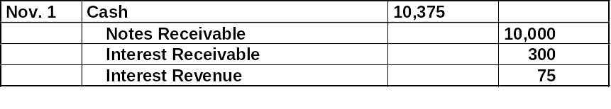
HONOR OF NOTES RECEIVABLE
When interest has been accrued, it is necessary to credit Interest Receivable at maturity.

Slide 43
DISHONOR OF NOTES RECEIVABLE
Nov. 1 Accounts Receivable 10,375
Notes Receivable 10,000
Interest Revenue 375
A dishonored note is a note that is not paid in full at maturity.
A dishonored note receivable is no longer negotiable.
Since the payee still has a claim against the maker of the note, the balance in Notes Receivable is usually transferred to Accounts Receivable.

Slide 44
BALANCE SHEET PRESENTATION OF RECEIVABLES
STUDY OBJECTIVE 9
In the balance sheet, short-term receivables are reported in the current assets section below short-term investments.
Report both the gross amount of receivables and the allowance for doubtful accounts.

Slide 45
ACCOUNTS RECEIVABLE TURNOVER RATIO AND COMPUTATION
Ratios are computed to evaluate the liquidity of a company’s accounts receivable.
Accounts receivables turnover ratio used to assess the liquidity of the receivables.
If Cisco had net credit sales of $18, 915 million for the year and beginning net accounts receivable balance of $1,466 million and ending net accounts receivable balance of $1,105 million, then:
$18,915 / ($1,466 + $1,105)/2 = 14.7 times
Average Net
Receivables
Accounts
Receivable
Turnover
Net Credit
Sales
/
=

Slide 46
AVERAGE COLLECTION PERIOD FOR RECEIVABLES FORMULA AND COMPUTATION
Variant of the turnover ratio that makes liquidity even more evident.
This is done by dividing the turnover ratio into 365 days. The general rule is that the collection period should not exceed the credit term period.
Cisco’s turnover ratio is computed as:
Days in Year/AR Turnover = Average Collection Period in Days
365 days / 14.7 times = 24.8 days

Slide 47
Which of the following statements about VISA credit card sales is incorrect?
Review
The credit card issuer makes the
credit investigation of the customer.
The retailer is not involved in the
collection process.
c. Two parties are involved.

Slide 48
Which of the following statements about VISA credit card sales is incorrect?
Review
The credit card issuer makes the credit investigation of the customer.
The retailer is not involved in the collection process.
Two parties are involved.

Slide 49

COPYRIGHT
Copyright © 2005 John Wiley & Sons, Inc. All rights reserved. Reproduction or translation of this work beyond that permitted in Section 117 of the 1976 United States Copyright Act without the express written consent of the copyright owner is unlawful. Request for further information should be addressed to the Permissions Department, John Wiley & Sons, Inc. The purchaser may make back-up copies for his/her own use only and not for distribution or resale. The Publisher assumes no responsibility for errors, omissions, or damages, caused by the use of these programs or from the use of the information contained herein.

